Slide 1
Prison Rape Elimination Act
PREA Refresher Course

Slide 2
Dynamics of Sexual Abuse

Slide 3
Consequences of Sexual Abuse
Sexual abuse in custody…
Triggers new mental illnesses and exacerbates existing ones
Spreads infectious diseases
Increases health and mental health care expenditures

Slide 4
Dynamics of Sexual Abuse
Predators look for means, opportunity, and vulnerability by selecting targets…
who are least able to defend themselves,
who may be less believed or believable, or
who are disliked or ostracized.
(Dumond, 2005)

Slide 5
Resident Predators
Likely to be older
Have been incarcerated for longer period of time
Physically aggressive
Manipulative
Often members of a security threat group or gang

Slide 6
Dynamics of Sexual Abuse
In women’s and girl’s facilities, relationships and loyalty tend to be valued highly. Men’s and boy’s facility cultures can value aggression and power.
Some see sexual aggression as a way to assert their power and control over others.
Being victimized and seeking help often are viewed as signs of weakness.

Slide 7
Dynamics of Sexual Abuse
Aggressors typically employ one of several methods to control victims:
Force (physical assaults or threats of harm)
Entrapment or blackmail (for example, requiring debts to be repaid with sex, protection)
Pressure tactics (persuasion, bribes, use of alcohol and drugs)
Remember that coercion ≠ consent

Slide 8
Dynamics of Sexual Abuse
Anyone can be at risk, but residents are more vulnerable if:
Young and inexperienced
First-time/new to confinement
Are not “tough” or “streetwise”
Have mental illnesses or developmental disabilities
Incarcerated for sexual violence against children or vulnerable adults

Slide 9
Vulnerable Populations
Educating ourselves about the characteristics of our population will greatly assist in preventing and detecting sexual abuse.
Staff should also know what characteristics make a resident more vulnerable to abuse as well as what characteristics make a resident more prone to predatory activity.

Slide 10
Vulnerable Residents
Someone who seems weak, or who is not streetwise
People with mental illness or developmental disabilities
Those incarcerated for sexual violence against children or vulnerable adults

Slide 11
Resident Victims
Previous victims of sexual abuse
Those residents disliked or are otherwise isolated from staff and other residents
Those residents who are least likely to be believed

Slide 12
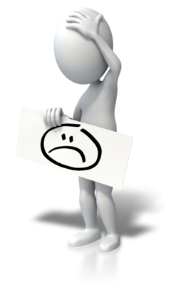
Common Reactions of Sexual Abuse Victims
Anger
Anxiety
Depression
Disbelief
Fear
Numbness
Guilt
Shame

Slide 13
Dynamics of Sexual Harassment
May precede sexual abuse and is used to
test a target
demean others
overtly or subtly intimidate
challenge new residents or staff
threaten residents or staff who are perceived to be weaker
May be used
To move the alleged perpetrator
To retaliate against the alleged perpetrator

Slide 14
This is the end of the section

