Slide 1
Prison Rape Elimination Act
PREA Refresher Course

Slide 2
Prevention and Detection

Slide 3
Prevention
Enforcing the agency’s policy on zero tolerance by following procedures and rules.
Supporting the agency’s sexual abuse reporting policy. If you see misconduct you are expected to report it- consistently and fairly.
Familiarizing yourself with your surroundings-be aware of and respond to lapses in safety and security.
Be sure to actively supervise residents—keep alert at all times, move around the group constantly, and engage youth.
Conducting quality supervisory rounds- leaders should be visible and active in the facility, engaging both staff and residents.

Slide 4
Prevention
General prevention planning shall include the following:
Knowing the PREA coordinator or compliance manager for your facility.
Knowing the procedures for reporting abuse.

Slide 5
Detection
Prevention and detection go hand in hand.
Detection means knowing your environment so that you are keenly aware when a resident or staff member is acting in an unusual or peculiar manner.

Slide 6
Staff Responsibilities
Staff responsibilities in working with youth
Staff sets the “tone” for relationships.
Staff brings own issues to the workplace.
May or may not have good boundaries or healthy relationships.
Way of relating to youth and adults may be a function of age (e.g., younger staff more aligned with youth than older staff).
May not know how to constructively deal with sexual issues with youth.
May communicate their own bias regarding sexual orientation/gender identity.

Slide 7
Avoiding Inappropriate Relationships
Personal Boundaries
Professional Boundaries
Pay attention to signs
Identify and respond to “red flags”

Slide 8
RED FLAGS

Slide 9
Red Flag Indicators Examples of red flag indicators are as follows:
Isolation
Depression
Lashing out at others
Refusing to shower
Suicidal thoughts or actions
Seeking protective custody
Refusing to leave an empty
cell
Refusing to enter an
occupied cell or transport
vehicle
Increase in misconduct
Increase in sexualized language and conversations
Change in relationships with other residents
Unusual aggressiveness, may attempt to fight
Lingering near staff
Requesting administrative segregation

Slide 10
Resident Red Flags
Spending time with a particular staff member
Leaves area when a particular staff shows up
Using staff member’s first name
Developing medical symptoms
Increase in misconduct

Slide 11
Red Flags: Staff
Calling out a resident at odd times
Dropping into work at odd times
Defending the resident by interceding on his/her behalf
Inappropriate sexual conversation/materials at work
Personal problems or life changes
Coming to work early or staying late to talk to a specific resident
Resident having access to more privileges

Slide 12
Red Flags: Environment
Increased fights on the unit
Other youth separating from another
Youth wanting to talk to staff alone
Increases in housing change requests
Unusual contraband
Other staff members staying away from a particular staff member
Flirtatious language

Slide 13
Signs of Potential Inappropriate Boundaries
Isolation from family/friends
Isolation from other staff
Confusion about boundaries
Lack of clear vision and policies form agency leadership
Stressed out/over-worked
Mandated overtime for extended periods of time, staff shortages
Lonely or going through difficult personal challenges
divorce, family conflicts, financial difficulties
Using alcohol or substances to cope
Feeling like no one cares/understands
Sexual frustrations or inactivity

Slide 14
Challenging Boundaries: Working with Youth
Staff want to be helpful to youth, yet remain professional
A resident may remind you of a child you know outside of work
Staff need to build trust-based relationships with youth while simultaneously staying professional
Staff may fall into parenting the youth instead of teaching them (being a professional role model for the youth)
Notes:
.

Slide 15
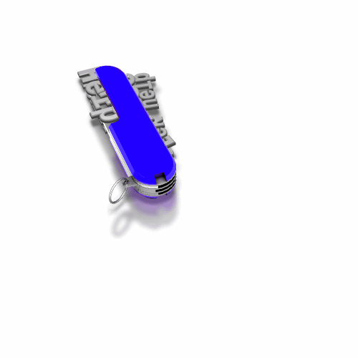
Communication Tools
All staff should be able to:
Clearly communicate boundaries
Seek help and advice if having problems
Confront co-workers if they observe problem behaviors
Model positive interactions

Slide 16
This is the end of the section

